Slide 1



Do you need an interpreter?

Slide 2

Help is here!
If you haven’t already,
Meet LanguageLine
240+ On-Demand Audio Interpreting Languages
Instantly Connect to Live, Professional Interpreters 24/7

Slide 3
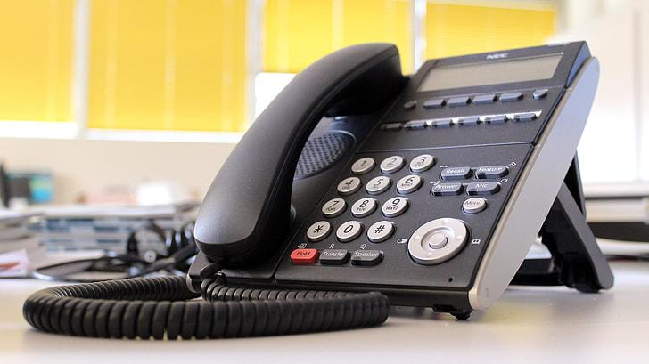
How are we already using LanguageLine
in Pitt County Schools ?
School Nurse reminders about Health Assessments/Vaccinations
Discipline Referrals
Concerns from counselors
IEP Meetings
Medical Emergencies
Transportation Changes
Enrolling New Students
Classroom Teacher updates about student progress
Front Office This is a valuable resource for welcoming Language Minority Families into our schools!
Share this information with your ENTIRE Staff!

Slide 4

Before you use
Language Line…
Please Complete the Language Line Usage Request Form
Failure to get approval from Federal
Programs will result in your school
having to pay for the call!

Slide 5
Managing Cultural Differences
Interpreters help overcome language and cultural barriers. When working with ML families keep in mind:
Cultural Sensitivity. An ML’s culture, traditions and experiences may be very different from our own. Understand differences exist. Be non-judgmental.
Indirect Communication. English is a direct language. In other languages and cultures, it often takes longer to get to the point—even during emergencies. Understand this issue and be patient.
Education. ML persons may not be familiar with practices common to us. To improve communication and reduce confusion, offer explanations when possible to bring ML customers into the mainstream.
Simple Language. To improve understanding, use simple language and ask for clarification if needed.
Your Manner. Be respectful and speak in a neutral tone.
Notes:
5

Slide 6

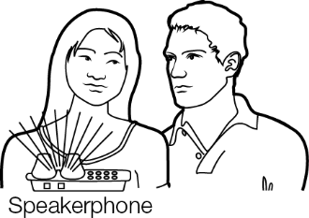

Accessing an Over-the-Phone Interpreter
*To use LanguageLine, you must set a time with the parent and have them present at school with you or at their home, ready to answer your phone when you call.
DIAL assigned toll-free number 866-874-3972
PROVIDE your Client I.D. 535423
INDICATE: Language or Press
    2 for all languages and clearly state the language
    0 if you don’t know what language you need
PROVIDE your 3-digit school code
PROVIDE your 2-digit reason code (See slide 10)
CONNECT to the linguist Once the interpreter comes on the line, they will ask your first and last name. They will ask if the client is with you or if you need for the interpreter to dial out for you. If there is no answer, the interpreter can leave a message.
WORKING WITH AN INTERPRETER – At the beginning of the call, briefly tell the interpreter the nature of the call. Speak directly to the limited English proficient individual, not to the interpreter, and pause at the end of a complete thought. Please note, to ensure accuracy, your interpreter may sometimes ask for clarification or repetition.
LEP=Limited English Proficient
ML=Multilingual Learner

Slide 7
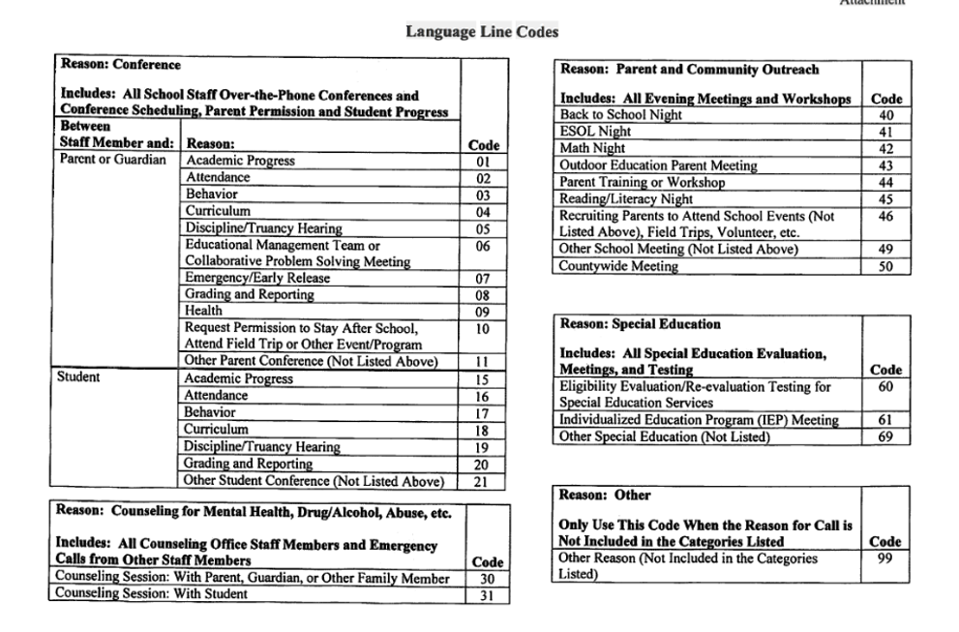
2-Digit Reason Codes

Slide 8
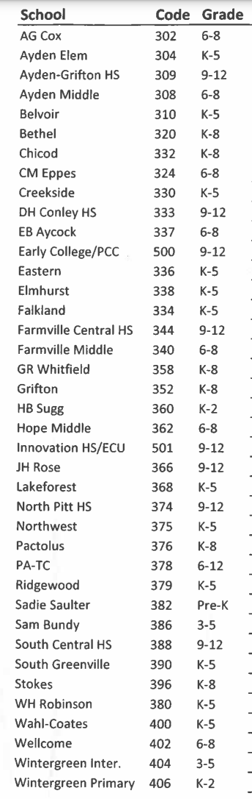
PCS Site Codes

Slide 9

Working with the Interpreter
Brief and update the interpreter
  Introduce yourself and state the goal of the encounter.
Communicating with the customer
  Retain control of the call. The interpreter will assist with communication, but you drive the conversation.
  Use first person at all times. “How are you doing today?”
  Speak in short sentences, using 3-5 sentence segments and pause at the end of a thought.
  Avoid jargon, slang and complicated technical terminology
  If you sense that the customer does not understand, try to rephrase , explain or repeat what you have said.
  Remember, whatever the interpreter hears will be interpreted. Avoid private conversations.
Best Practices Documentation – For Each Interpreter Interaction:
  Document the linguist name & number

Slide 10


Language Line Customer Service
Voice of the Customer:
If you wish to submit a comment or feedback to LanguageLine, visit their website at www.languageline.com and mouse over Client Services and click on Voice of the Customer. You may submit a Voice of the Customer (VOC). They welcome your communication.
Customer Care : 800.752. 6096 Option 2
Notes:
10

Slide 11
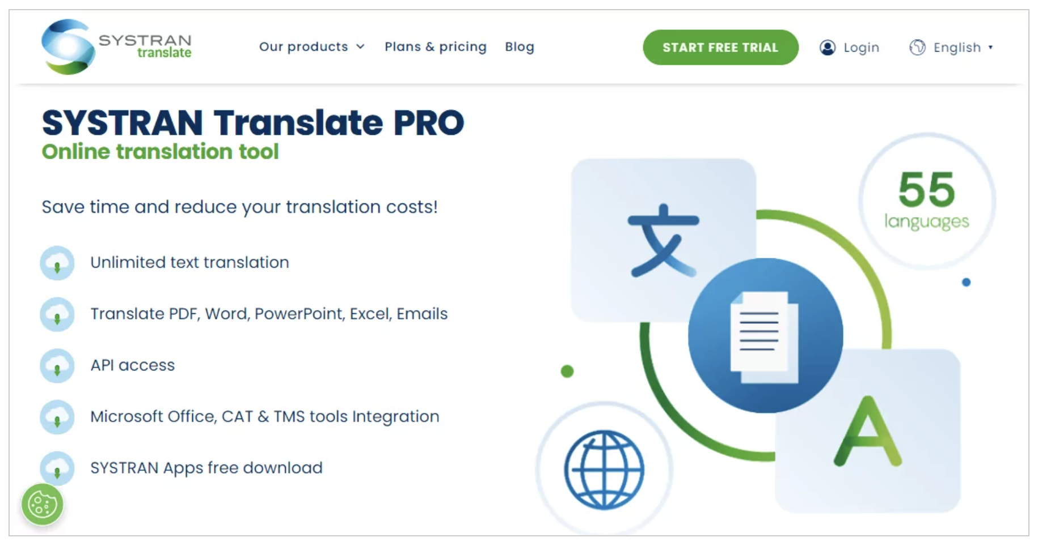


Do you need a document translated?
Available Languages

Slide 12
Translating documents
Permission slips
Newsletters
School announcements
Parent Conference requests
Anything that goes home on paper in English!
PLEASE NOTE: This resource is NOT to be used for translating assignments. Teachers should be modifying assignments so that MLs can be engaged with grade-level content.
Ask your EML Teacher for login information!

Slide 13

Questions about
LanguageLine or SYSTRAN?
Contact Hannah Butler
butlerh@pitt.k12.nc.us

